Slide 1
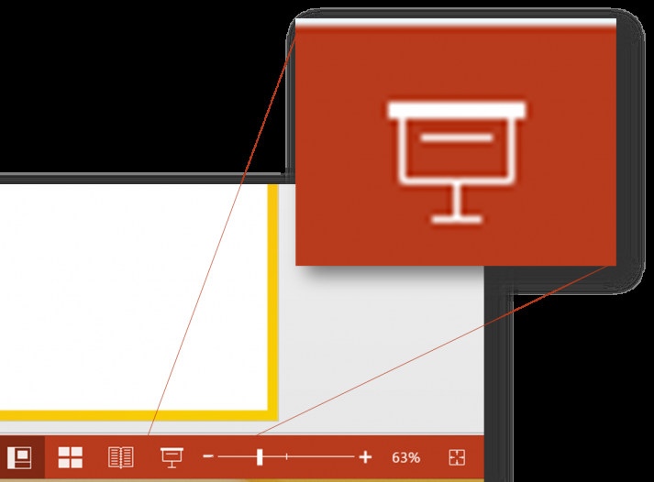
Tiered Vocabulary
Press F5 or click the start presentation icon on the bottom toolbar
Click for audio
A Virtual Assembly With Miss Dudley

Slide 2
Tiered What?
Click for audio
Tiered vocabulary refers to three tiers of vocabulary.
We will be using this when we refer to groups of words, in all your subjects.
You will be encouraged to make use of Tier 2 Vocabulary in all your written work, and ensure you have a solid understanding of Tier 3 Vocabulary.

Slide 3
Tiers 1-3
Click for audio

Slide 4
Why it is important
Click for audio
Being confident with academic vocabulary will increase your success in your lessons, exams and your future.
Extending your vocabulary in your writing makes you sound more intelligent!
Many of the Tier 2 words will help you access Tier 3 words which will support your understanding of your subjects.

Slide 5
How will this affect lessons?
Click for audio
Your teachers will make the teaching of vocabulary more explicit in lessons.
You will have more opportunities to break down meanings of words which will in turn help you to understand even more words.
You will use a model called the Frayer model to secure your understanding of Tier 2 and 3 words.

Slide 6
Click for audio

Slide 7
Click for audio

Slide 8
Starting from when?
Click for audio
This will launch in September 2020
We hoped to see you before then but given the current situation, this is the best way to prepare you
It will become clearer during your lessons
Your teachers have been working very hard on ensuring we teach in a way that is word conscious to extend your vocabulary.

Slide 9
How will this benefit me?
Click for audio
Improved understanding
Increase in academic success
Better spelling
Writing will be more academic
Supports exam success
Better future

Slide 10
Any Questions?
Click for audio
Please email me on l.dudley@huxlow.northants.sch.uk
I look forward to seeing you in September

